Slide 1

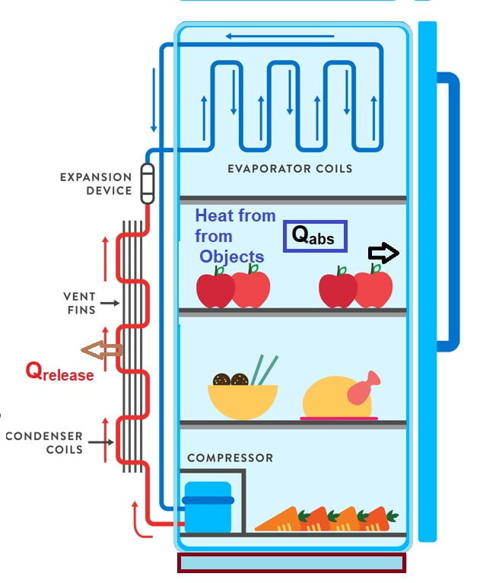
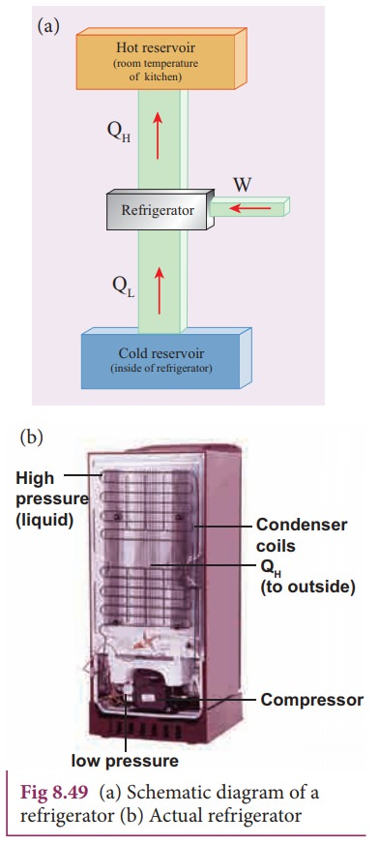
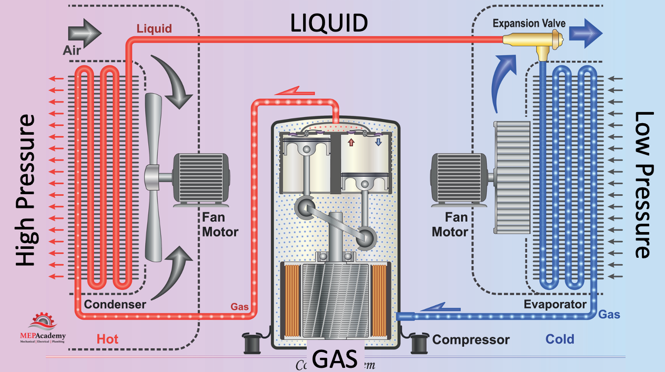
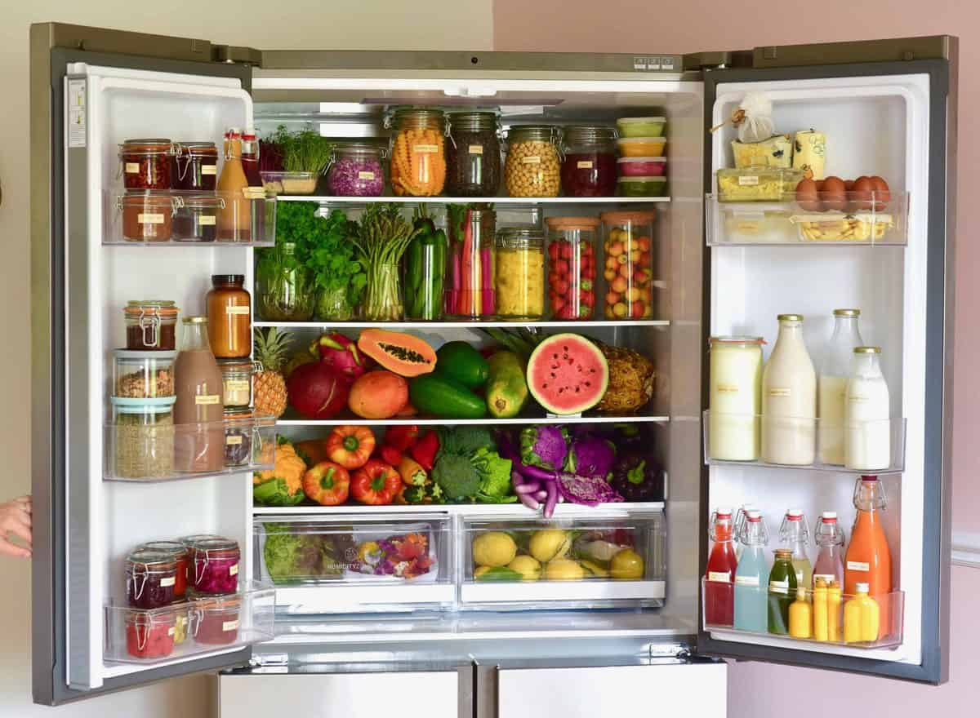
American International University-Bangladesh (AIUB) 408/1 (Old KA 66/1), Kuratoli , Khilkhet , Dhaka 1229, Bangladesh
Instructor :TUSAR SAHA
LECTURER, Faculty , DEPARTMENT OF NATURAL SCIENCE [PHYSICS]
PHYSICS 2 GROUP 3
SEC [CC]
PARAG SARKAR JOY MD BONY AMIN MD RAKIBUL ISLAM
24-56960-1 24-56311-1 24-56314-1
Introduction Significance Contribution to the Society
Objective Study and Development Conclusion
Future Scope
APPLICATION OF THERMODYNAMICS PRINCIPLES IN REFRIGERATION TECHNOLOGY
SIGNIFICANCE :
✓ Thermodynamic optimization saves energy.
✓ Lower energy consumption saves cost.
✓ enhances system performance.
✓ efficient systems minimizes greenhouse gas emissions.
✓ Innovation in refrigeration technology opens new business opportunities.
INTRODUCTION
Thermodynamics deals with the relationships between heat, work, temperature, and energy . Vapor compression cycle is the foundation of most refrigeration systems . cycle efficiency through innovation can maximize cooling capacity & minimize energy consumption .
In 1755 William Cullen , Scottish scientist conducted experiments on the cooling effect of evaporation, making an early milestone in refrigeration history.
STUDY & DEVELOPMENT
❑ Environment Friendly Refrigerants are developed with
low Global War Magnetic refrigeration utilizes magnetocaloric materials
❑ Magnetic refrigeration utilizes magnetocaloric materials.
❑ inverter technology improves energy efficiency.
❑ nanofluids and nano-enhanced materials improve heat
exchanger performance and system efficiency.
❑ real time monitoring,predictive maintenance,optimized
performance by IOT technology.
OBJECTIVE
CONTRIBUTION TO THE SOCIETY
Thermodynamics principles are applied in refrigeration technology, focusing on heat transfer mechanisms, Vapor-Compression Cycle, energy efficiency, and refrigerant selection. Applications include domestic, industrial, and cryogenics, aiming to minimize energy consumption.
➢ reduce food waste.
➢ maintain the nutrition value of foods.
➢ Preserve medicines, vaccines, organs & tissues.
➢ supports the global food industry, facilitates trade and economic growth.
➢ Enhance food security and combat hunger by extending the shelf life of perishable items. ➢ Promote sustainability by reducing reliance on excessive production to offset losses from spoilage. ➢ Ensure safe storage of critical biological samples for research and medical purposes.
FUTURE SCOPE
❖High-efficiency refrigerants to improve thermodynamic efficiency.
❖magnetocaloric refrigeration enhanced thermodynamic cycles.
❖Integration with renewable energy sources. ❖Use of nanotechnology and advanced materials & insulation materials.
❖ Development of eco-friendly refrigerants with zero ozone depletion potential (ODP) and low global warming potential (GWP). ❖ Smart refrigeration systems equipped with IoT for real-time monitoring, diagnostics, and energy optimization. ❖ Application of AI and machine learning for predictive maintenance and process optimization. ❖ Advancements in cryogenic technology for ultra-low temperature applications. ❖ Exploration of thermoelectric cooling systems for compact and noiseless refrigeration solutions.
REFERENCES
✓Wikipedia/First_law_of_ thermodynamics
✓Wikipedia/Magnetic_ refregeration ✓Sciencedirect.com/refrig eration_cylce ✓Hvacrnews.com/role_of_ refregeration ✓Powerscientific.com
✓Khan Academy/thermodynamics
✓ResearchGate
CONCLUSION
By applying fundamental thermodynamic principles, engineers have developed more efficient, eco-friendly, and cost-effective refrigeration systems. Overall, leveraging thermodynamics in refrigeration leads to significant societal and environmental benefits

